Slide 1
Module 11

Slide 2
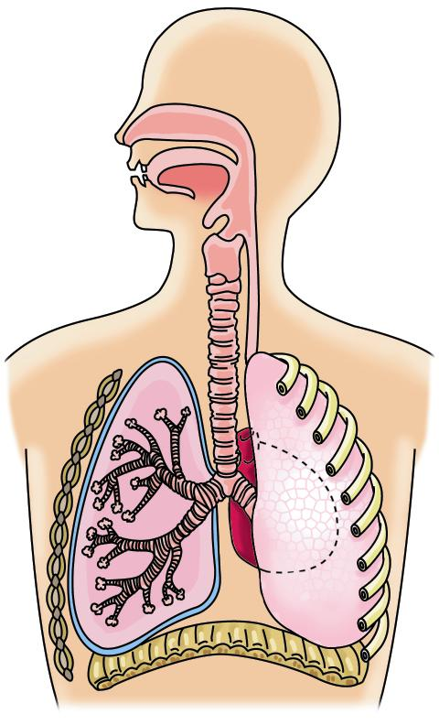
Human Respiratory system consists of
The process of respiration in human beings occurs in a special system called as Respiratory system.
Nostrils
Branches of wind pipe
Voice box
Wind pipe
Pharynx
Bronchioles
Larynx
Trachea
Bronchi

Slide 3
Nostrils
Opening of the nose

Slide 4
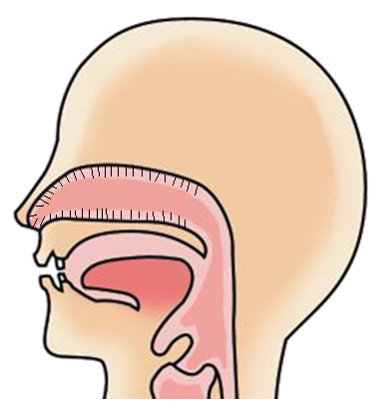
Inside the passage there are
Air passes through the nostrils
FINE HAIR
Thin
Air gets filtered by the fine hair
Air becomes moist and warm

Slide 5
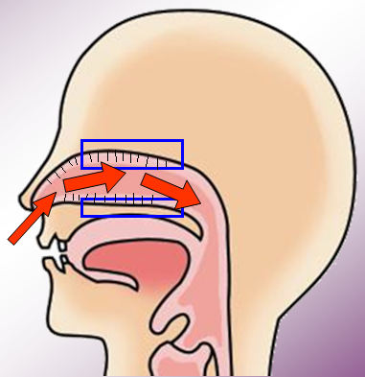
Inside the nose there are special mucus secreting cells.
They secrete mucus which traps the dust particles.
Dust Particles
Mucus
Mucus-secreting cell

Slide 6
The respiratory tract includes
Respiratory organs
The trachea has rings of cartilage which ensure that the air-passage does not collapse
Nostrils
Muscular partition between chest and abdomen
Branches of wind pipe
Voice box
Wind pipe
Pharynx
Small balloon like sacs
Larynx
Bronchioles
Trachea
Bronchi
Lungs
Alveoli
Diaphragm
..Diagram

Slide 7
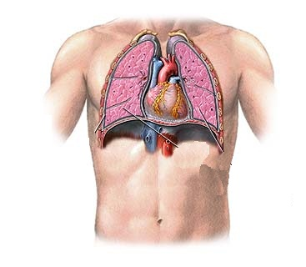
The lungs are located in thoracic cavity.
Chest
Thoracic cavity.
Lungs

Slide 8
Thank You

